Slide 1
NASDEV BEST PRACTICE SUMMIT MASTERCLASS
Exploring Complexity in South African Higher Education:The Place of Digital Transformation in Student Affairs

Slide 2
https://questionpro.com/t/AX59zZyQGI

Slide 3
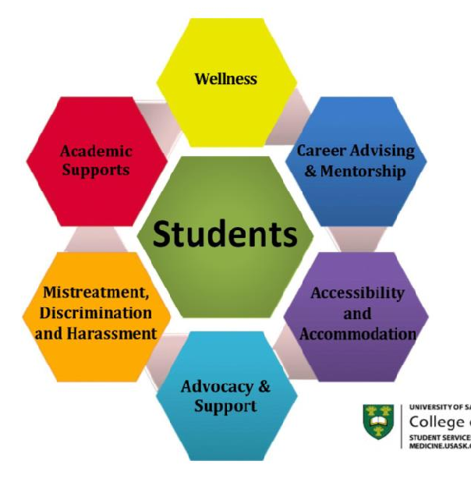
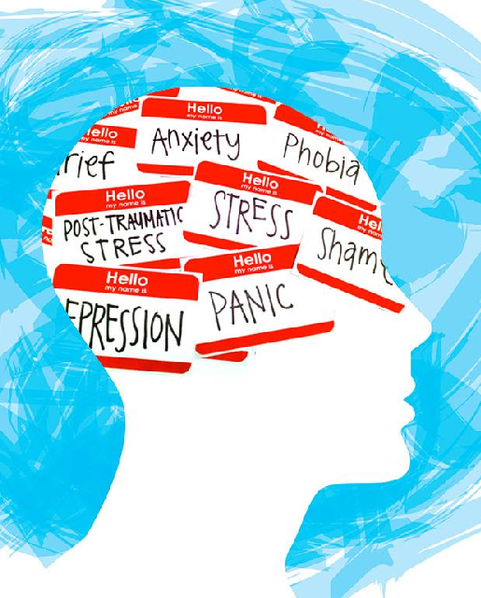
State of the Art

Slide 4
Transforming Higher Education – The Digital University
‘Intelligent Digital’ is the new normal and universities must balance business understanding with technology innovation and student insight to truly meet staff and student’s needs.

Slide 5
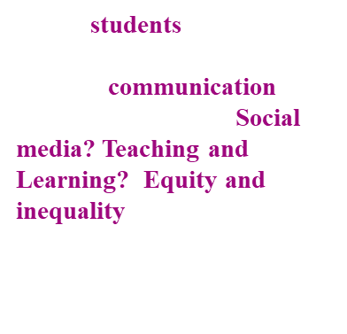
Literature Review Summary
Learning in higher education, that relate to health benefits, civic engagement, and inter-generational mobility. The dominant approach to student success measures it in numerical terms, for example in terms of student retention. Emerging theme that challenges the dominant discourse and demonstrate that students do not only define success as the attainment of academic qualifications but also define success in more nuanced interpretations that stem from what success means at a personal level informed by lived experiences.
Systems thinking enables organizations to look at an entire ecosystem, recognize patterns and the interrelationship of patterns in an ecosystem for the purpose of structuring the interrelationships of patterns for organizational effectiveness and efficiency (Senge, 1990; von Kutzschenbach, 2017).
Student Affairs task at its core is to address fundamental and developmental needs that include counselling, admissions, campus safety, career services, race, diversity and inclusion, financial aid, international student support, student discipline, LGBTQIA and underrepresented groups, residential life, student activities athlete support and student government and leadership.
Campus Management Integration???

Slide 7
CONCEPTUAL FRAMEWORK
Complexity
Globalisation
Organisation
Systems Theory |  |  | Chaos Theory
Theoretical Basis
Complexity
Theory
Student Affairs as complex, adaptive systems
Dilemmas for Organisations
Research Questions
Research Methodology

Slide 8
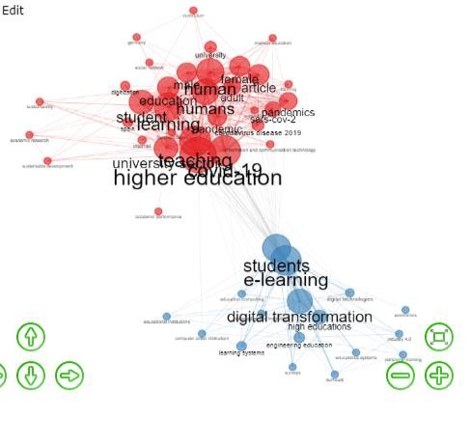
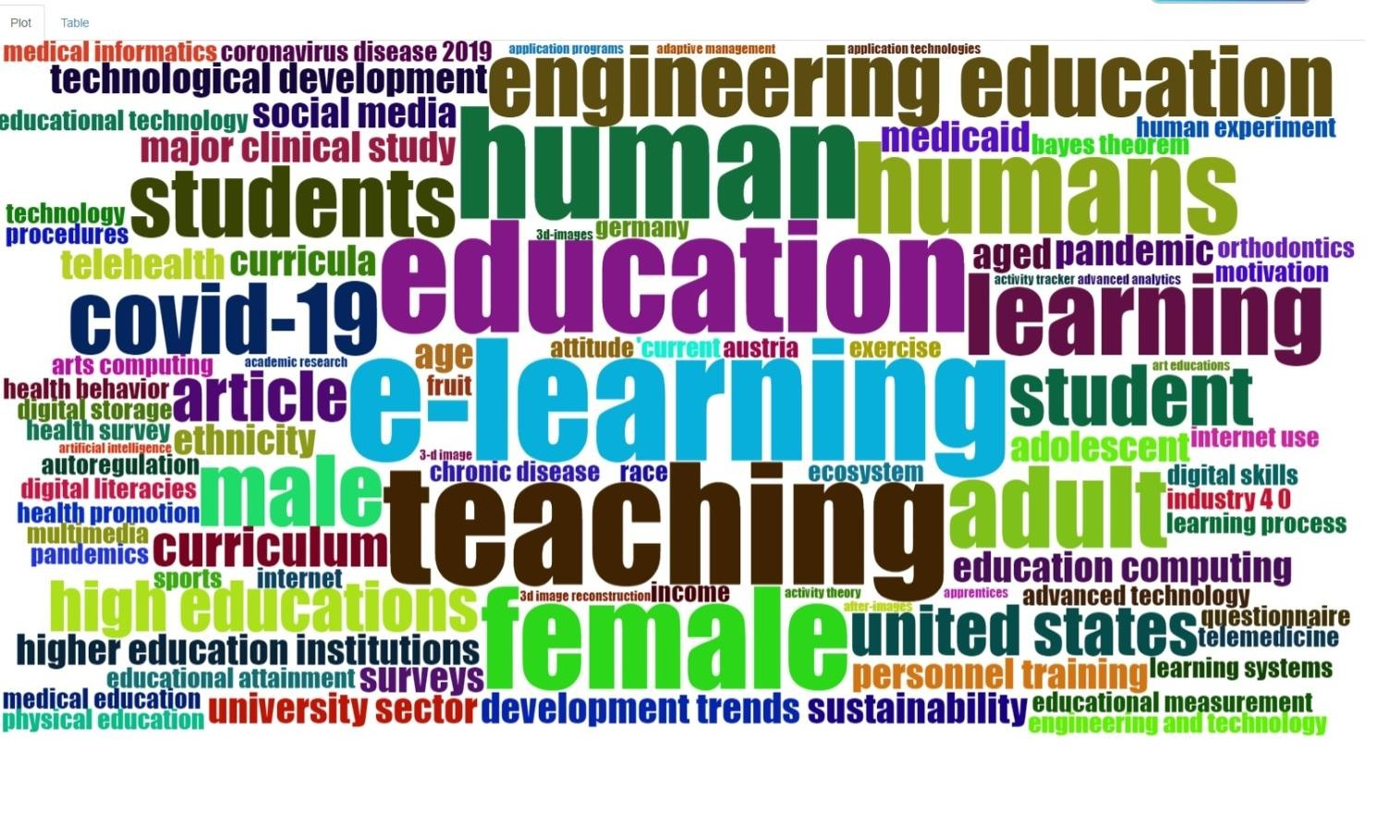
DIGI TA L
TRANSFORMATION AND
TRENDS IN HIGHER
EDUCATION
HIGHER EDUCATION
Cooccurrence Network
Word Cloud

Slide 9
While digital transformation has successfully transformed the teaching and learning arena, accompanied with a large corpus of literature and documented evidence, the Student Affairs arena has been left behind.
Problem Statement
There is a dearth of scholarship on digital transformation in the Student Affairs domain
Skills Gap?
Financial contribution?
Digitized Services?
What are you doing with your data?
What Now?

Slide 10
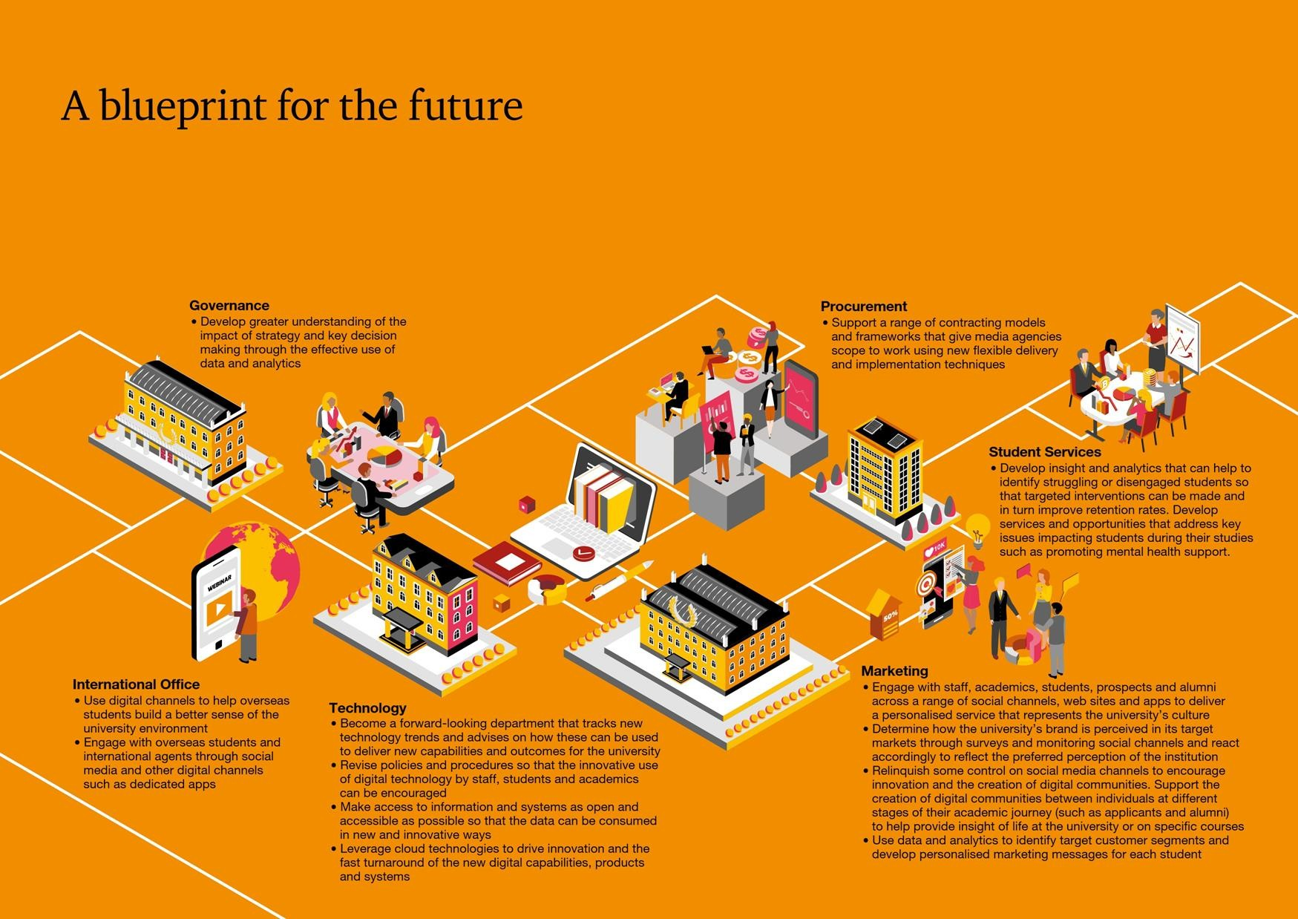

Slide 11
Findings

Slide 12
References

Slide 13
Thank You

